Slide 1
SAT&ACT Data Analysis 2017/2018
Findings & Recommendations
(Kelvin, Ivy, Guat Hwa)

Slide 2
Background
Both SAT and ACT are used as standardized testing for high school seniors to gain college admissions
Different states have different policies on test taking
Required SAT
Required ACT
Required Either
Optional
Some states offer Free Exam to all test takers

Slide 3
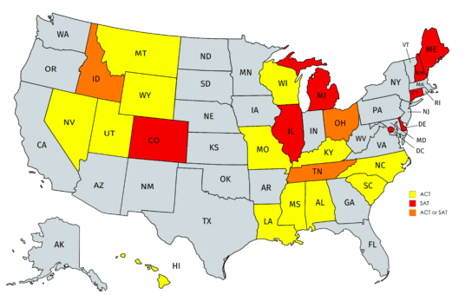
State’s Policy On Mandatory SAT/ACT

Slide 4
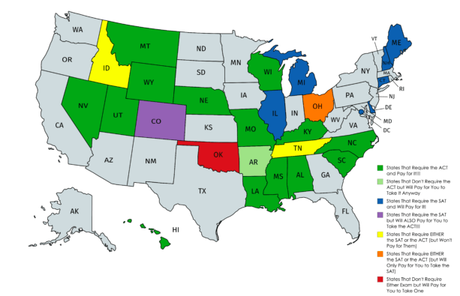

Slide 5
Problem Statement
Analyse and increase SAT participation rates

Slide 6
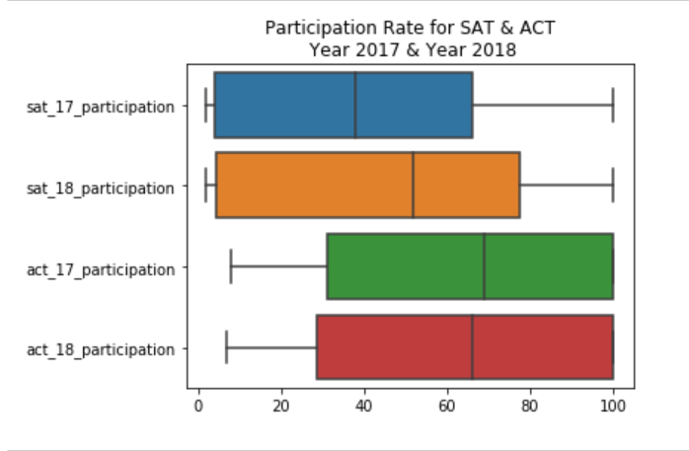
Overview on Participation Rate for SAT & ACT Year 2017 vs Year 2018
SAT Median Participation Rate
Year 2018- 5 States 100%
Year 2017- 4 States 100%
ACT Median Participation Rate
Year 2018- 17 States 100%
Year 2017- 17 States 100%

Slide 7
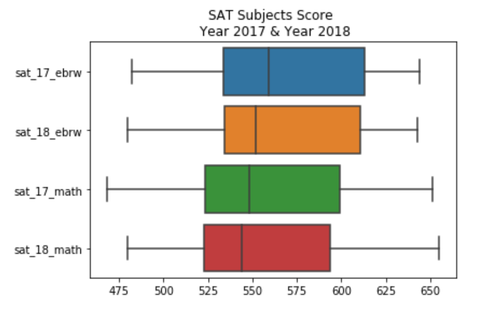
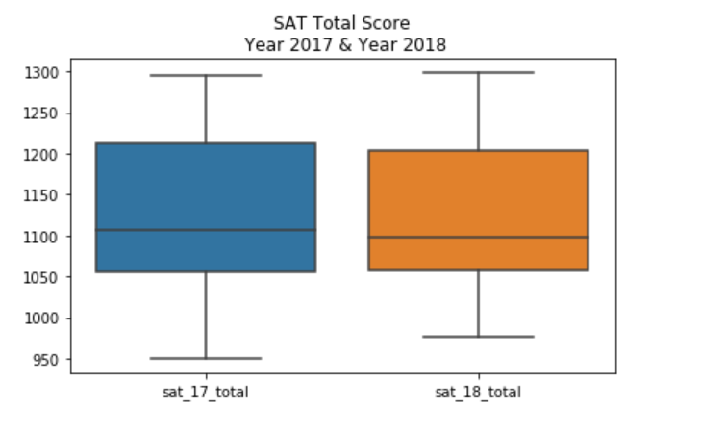
Overview on SAT Subject Score & Total Score Year 2017 vs Year 2018

Slide 8
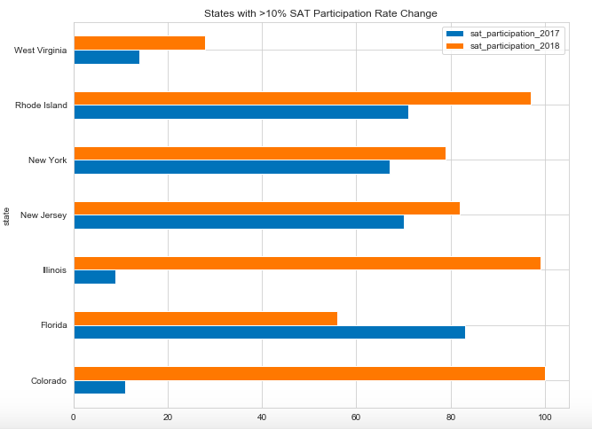
SAT Participation Rate Change > 10% (2017 vs 2018)
SAT : 71% to 97%
ACT: 21% to 15%
State policy change
Exam is free
SAT School Day
SAT : 19% to 99%
ACT: 93% to 43%
SAT : 11% to 100%
ACT: 100% to 30%

Slide 9
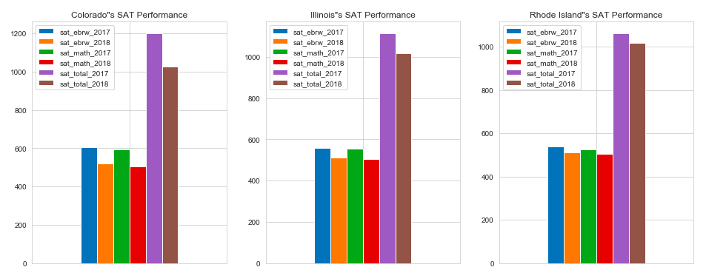
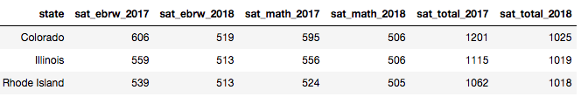
SAT Performance (Colorado / Illinois/ Rhode Island )

Slide 10
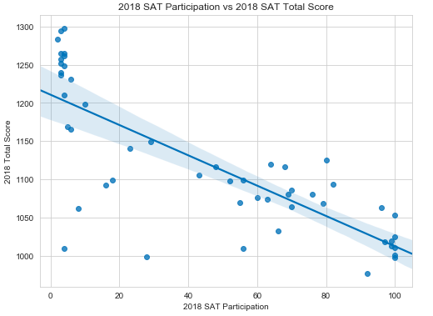
SAT Participation vs Total Score
Highest Score: Minnesota (SAT Score: 1298)
(SAT Participation: 4%)
Higher participation rate but lower total score

Slide 11
SAT Score and Participation (2017/2018)
Highest Score: Minnesota (SAT Score: 1298) (SAT Participation: 4%)
Because more students in Minnesota take the ACT than they do the SAT, Minnesota's high average SAT score likely means that only the most prepared, ambitious high schoolers take the SAT. These students tend to score higher, effectively raising the state's average.

Slide 12
Recommendations
Mandating the completion of the SAT for all high school students
Covering all of part of the exam fees (USD 113.50)
Offering the SAT during regular school hours to make student participation as convenient as possible
Make SAT as mandatory requirement for college admission
AND
Offering free test preparation program. eg have access to the Official SAT Online Course, Khan Academy’s free online practice problems and instructional videos.
Provide additional academic support for students who may need it

Slide 13
Recommendations
State : Alaska
Low participation for both SAT / ACT
SAT (2018) – 43%
ACT (2018) - 33%
Reference: https://www.juneauempire.com/opinion/opinion-forget-the-national-average-university-of-alaska-requires-a-higher-level-of-state-investment/

